Slide 1
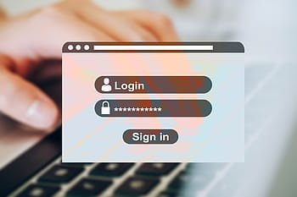
Bank Management System
Providing secure and efficient net banking facilities

Slide 2

Overview of Internet Banking System
Java-based Engineering Project
The Internet banking system is a convenient and secure way to manage financial transactions.
It allows users to access their accounts, transfer funds, pay bills, and view transaction history online.
The system is built using Java programming language, which offers scalability, flexibility, and security.
With the integration of various technologies, such as encryption and authentication mechanisms, it ensures the protection of sensitive user data.
Photo by Pexels

Slide 3

Secure Login
Login with ID and Password
Users can securely login through a web page
Account login ID and password are required
Title and subtitle must be catchy and concise
Slide content should not exceed 18 words per paragraph
Photo by Pexels

Slide 4
Banking Facilities
All banking customers can access various options and features such as money transfer
1
These facilities include online banking, mobile banking, and ATM services
2
Customers can transfer funds between their own accounts or to other people within the bank
3

Slide 5

Money Transfer
Transfer money easily
Customers can transfer money to Western Union, interbanking, or other banking customers by adding them as payees.
This convenient feature enables customers to send money securely and efficiently.
Transfer funds quickly and hassle-free using our user-friendly platform.
Enjoy the convenience of transferring money to various banking channels with just a few clicks.
Photo by Pexels

Slide 6
Advantages of Internet Banking System
Benefits
Drawbacks
Convenient and accessible - Customers can access their bank accounts and make transactions anytime and anywhere.
Time-saving and efficient - Online transactions can be completed quickly and without the need for physical paperwork.
Cost-effective - Internet banking reduces the need for physical bank branches, resulting in lower operational costs for both banks and customers.
Security risks - Internet banking is vulnerable to hacking and online fraud, requiring strong security measures to protect customer data.
Dependence on technology - System outages or technical glitches can disrupt online banking services temporarily.
Limited personal interaction - Online banking lacks the personal touch of face-to-face interactions with bank staff.

Slide 7

System Architecture
Apache & MYSQL
Apache Server Pages (ASP) is a technology used to develop dynamic web pages.
MYSQL database is used to store and retrieve data for the bank application.
ASP allows for server-side scripting, making it easier to create dynamic and interactive web pages.
By using MYSQL, the bank application can easily manage customer data, transactions, and more.
Photo by Pexels

Slide 8
Timeline of Project Development
Planning Phase
This phase involved gathering requirements and defining project scope.
Design Phase
During this phase, the project's architecture and layout were created.
Development Phase
The actual coding and implementation of the project took place in this phase.

Slide 9

Challenges Faced
Potential Issues
One challenge encountered during development was integrating multiple software components.
Another challenge was ensuring compatibility across different operating systems and devices.
Deploying the system required addressing security concerns and protecting sensitive data.
Additionally, scaling the system to handle increasing user demand posed a significant challenge.
Photo by Pexels

Slide 10

Conclusion
Importance
The Internet banking system is a crucial part of modern finance.
It provides convenience and accessibility for customers to manage their finances.
With Java-based engineering, the system is robust and secure.
It allows for seamless integration with other banking services.
Photo by Pexels

Slide 11
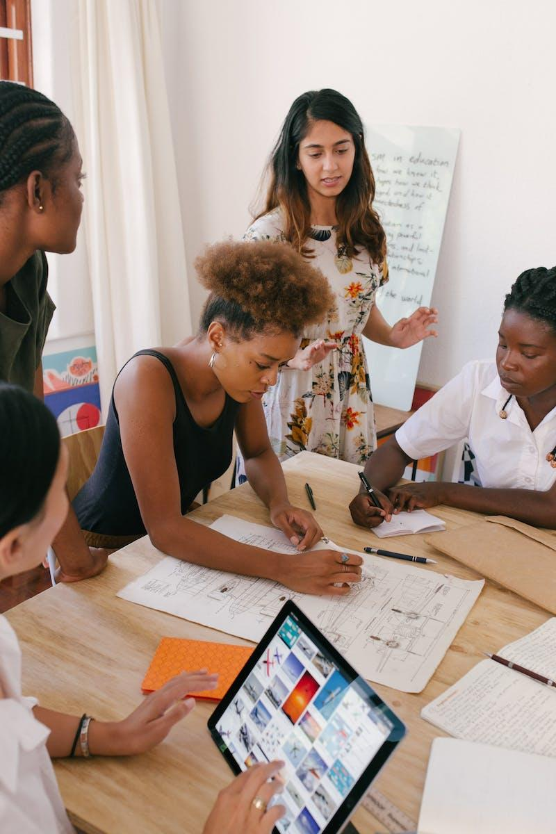
Thank You
Great Presentation!
Thank you for your attention.
I hope you found the presentation informative.
If you have any questions, please feel free to ask.
I appreciate your time and engagement.
Mr. Yash Kansal
Roll No.- 2219969
CSE-F1-III-Sem
Session: 2023-2024
GEHU , Dehradun
Photo by Pexels

